Slide 1
Current Interstate Maintenance Services Contracts
 | Type | District / Area | Contractor | CL / Lane | Start Date | End Date | Years in Effect
 | BIMS | Fredericksburg | DBI | 47 / 282 | 4/1/2015 | 3/31/2020 | 5
 | BIMS | NOVA I-495 | DBI | 18 / 242 | 4/1/2015 | 3/31/2020 | 5
 | BIMS | NOVA I-95 / I-395 | DBI | 36/325 | 4/1/2015 | 3/31/2020 | 5
 | BIMS | NOVA I-66 | DBI | 43 / 314 | 4/1/2015 | 3/31/2020 | 5
 | DIMS | Bristol | VDOT Bristol | 129/570 | 7/1/2012 | 7/20/2020 | 8
 | DIMS | Hampton Roads - Southside | VDOT Hampton | 109 / 768 | 5/15/2013 | 7/20/2020 | 7
 | DIMS | Culpeper I-64 & I-66 | VDOT Culpeper | 70/302 | 8/15/2015 | 7/20/2020 | 5
 | DIMS | Hampton Roads - Peninsula | VDOT Hampton | 43 / 274 | 8/1/2016 | 7/20/2020 | 4
 | DIMS | Richmond North | VDOT Richmond | 234/1598 | 7/1/2012 | 7/20/2020 | 8
 | DIMS | Salem | VDOT Salem | 125/530 | 9/8/2014 | 7/20/2020 | 6
 | DIMS | Staunton North | VDOT Staunton | 123/495 | 5/15/2013 | 7/20/2020 | 7
 | TAMS | Richmond South | DBI | 138 / 574 | 7/1/2012 | 6/30/2019 | 7
 | TAMS | Staunton South | DBI | 133/524 | 8/1/2011 | 7/31/2020 | 9
 | TAMS | Woodrow Wilson Bridge | DBI | 11/135 | 6/15/2010 | 6/14/2019 | 9

Slide 2
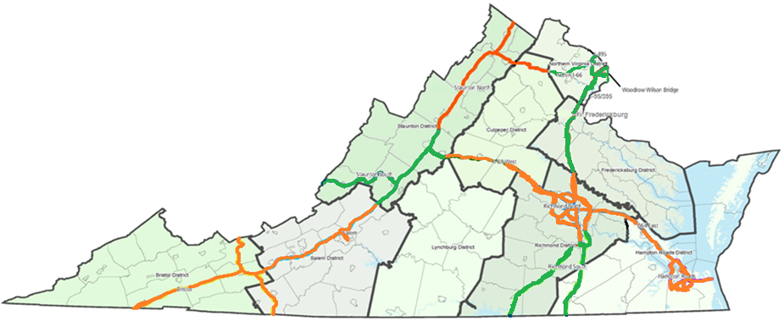

Current Performance Based Contracts Work Areas

Slide 3
Current Performance Based Contracts
Contract Segment | Current Contractor | Mileage | Routes | Start Date | End Date | Approx. Base Annual $
Staunton South | DBI | 133 CL miles/ 524 lane miles | I-81, I-64 | 8/1/2011 | 7/31/2020 | $2,400,000
Richmond South | DBI | 138 CL miles/ 574 lane miles | I-85, I-95, I-295 | 7/1/2012 | 6/30/2019 | $3,000,000
NOVA I-95 / I-395 | DBI | 33 CL miles/ 325 lane miles | I-95, I-395 | 4/1/2015 | 3/31/2020 | $2,200,000
NOVA I-66 | DBI | 43 CL miles/ 314 lane miles | I-66, SR-267 | 4/1/2015 | 3/31/2020 | $2,300,000
NOVA I-495 | DBI | 18 CL miles/ 242 lane miles | I-495 | 4/1/2015 | 3/31/2020 | $1,500,000
I-95 Fredericksburg | DBI | 47 CL miles/ 282 lane miles | I-95 | 4/1/2015 | 3/31/2020 | $1,700,000
NOVA Woodrow Wilson Bridge (WWB) | DBI | 11 CL miles/ 135 lane miles | I-95 | 6/15/2010 | 6/14/2019 | $7,300,000

Slide 4
Current VDOT Managed Interstate Contracts
Roadway Segment | Current Contractor | Mileage | Routes | Start Date
Hampton Roads Peninsula ‘Williamsburg’ | Hampton Roads District | 43 CL miles/ 274 lane miles | I-64 | 8/1/2016
Salem | Salem District | 125 CL miles/ 530 lane miles | I-81, I-581, I-77, SR460, SR220 | 9/8/2014
I-64 West | Culpeper District | 70 CL miles/ 302 lane miles | I-64, I-66 | 8/15/2015
Bristol | Bristol District | 129 CL miles/ 570 lane miles | I-81, I-77, I-381 | 7/1/2012
Richmond North | Richmond District | 234 CL miles/ 1598 lane miles | I-95, I-295, I-64, I-195, SR-288, SR-195, SR-76, SR-150, SR-146 | 7/1/2012
Hampton Roads Southside | Hampton Roads District | 109 CL miles/ 768 lane miles | I-64, I264,I-464, I564,I664, US58, US17 & others | 5/15/2013
Staunton North | Staunton District | 123 CL miles/ 495 lane miles | I-81, I-66 | 5/15/2013

